Slide 1


A
Project on
“Probabilistic-ML Framework for Extreme Flood Prediction” prepared by
Soham Shinde
Pratik Thokal
Kedar Bhasme
Harsh Patil
Dr. Vithalrao Vikhe Patil College of Engineering, Ahilayanagar
Department of Information Technology
Academic year: 2026-27
Dr. Vithalrao Vikhe Patil College Of Engineering
Department of Information Technology
Guided by
Reviewed by
Dr. D. A. Vidhate
Prof. P. S. Dolare

Slide 2
Index
Introduction
Abstract
Purpose, Scope & Objectives
Literature Survey
Problem Statement
Proposed System
System Architecture
Proposed Architecture
DFD (level 0, level1)
ER Diagram
Class Diagram
Use Case Diagram
Activity Diagram
14) State Diagram
15) Deployment Diagram
16) Results
17) System Requirements
18) Conclusion

Slide 3
Introduction
Floods are major natural disasters that cause significant loss of life, infrastructure, and economic resources.
Existing flood-risk assessment methods generally use statistical analysis or machine learning techniques independently.
Individual models have their own limitations and biases, which can affect flood-risk prediction.
Combining multiple approaches can provide a more reliable assessment of extreme flood risk.
The proposed system integrates statistical methods with machine learning techniques to improve flood-risk assessment and support decision-making.

Slide 4
Abstract
The proposed system assesses extreme flood risk using historical rainfall data.
It applies Extreme Value Analysis (EVA) to analyze extreme rainfall patterns and estimate flood return periods.
Multiple probability distributions are evaluated to identify the most suitable distribution for extreme rainfall analysis.
Random Forest, XGBoost, and Kernel SVM models are applied, and their outputs are combined using a Majority Voting Ensemble.
Results are presented through a Flood Risk Dashboard, providing predictions, susceptibility maps, return-period estimates, and analytical information.

Slide 5
Objectives
To develop a Java-based flood risk assessment system using historical rainfall and hydro-meteorological data.
To analyze extreme rainfall patterns using Extreme Value Analysis and probability distribution methods.
To predict and identify flood-prone regions using machine learning models.
To estimate return periods and generate flood susceptibility maps for extreme rainfall events.
To provide an interactive dashboard for visualization and support disaster management decisions.

Slide 6
Purpose
To develop a Java-based system for assessing extreme flood risk using rainfall data.
To analyze extreme rainfall patterns using statistical methods and probability distributions.
To identify flood-prone areas using machine learning models.
To estimate flood return periods for understanding future flood risk.
To provide an interactive dashboard for visualizing flood-risk results and supporting decision-making.

Slide 7
Scope
Flood risk prediction using historical rainfall and hydro-meteorological data.
Identification of flood-prone regions based on predicted flood risk.
Return period estimation for extreme rainfall events.
Flood susceptibility mapping and visualization through an interactive dashboard.
Decision support for disaster management authorities for better planning and risk management.

Slide 8
Literature Survey
Sr. No | Literature / Paper | Main Approach | Limitations / Gap | Relevance to Proposed System
1 | Fatima et al. (2025) – Integrating Machine Learning Models With Probability Distribution Methods for Extreme Flood Risk Assessmen - Nareem Fatima | Combines Probability Distribution Methods and Ensemble Machine Learning for flood risk assessment. | Requires multiple statistical and machine learning models, increasing system complexity. | Serves as the base paper and foundation for the proposed hybrid flood prediction system.
2 | Al-Aizari et al. (2024) – Uncertainty Reduction in Flood Susceptibility Mapping Using Random Forest and XGBoost Algorithms - Ali R. Al-Aizari | Uses Random Forest and XGBoost for flood susceptibility mapping. | Focuses mainly on susceptibility mapping. | Supports the use of RF and XGBoost in flood prediction.
3 | Hamidifar & Nones (2023) – Spatiotemporal Variations of Riverine Flood Fatalities - Michael Nones | Studies flood fatalities and flood patterns across regions. | Focuses on flood impact analysis rather than prediction. | Provides understanding of flood occurrence patterns and risk factors.

Slide 9
Literature Survey
Sr. No | Literature / Paper | Main Approach | Limitations / Gap | Relevance to Proposed System
4 | Murtaza et al. (2022) – Investigation of Runoff Variations and Flood Frequency Estimates of the Jhelum River - Roshni Thendiyath | Uses flood frequency estimation and runoff analysis techniques. | Limited to a specific river basin study. | Supports statistical flood analysis and return period estimation.
5 | Khwairakpam & Kundu (2024) – Significance of Different Probability Distributions in Flood Frequency Analysis of Brahmani-Baitarani River Basin, India - Robindro Singh Khwairakpam & Sananda Kundu | Uses probability distributions and goodness-of-fit techniques for flood frequency estimation. | Limited to probability-based flood frequency analysis of a specific river basin. Does not integrate machine learning prediction. | Supports probability distribution analysis, goodness-of-fit testing and extreme flood estimation in the proposed system.

Slide 10
Problem Statement
Climate change is increasing flood frequency and intensity. Traditional methods struggle to assess extreme flood events accurately, while manual identification is time-consuming. Therefore, hybrid statistical and machine learning approaches are needed.

Slide 11
Proposed System
The system collects and preprocesses historical rainfall and hydro-meteorological data to prepare it for analysis.
Extreme Value Analysis and multiple probability distributions are used to study extreme rainfall behaviour and estimate return periods.
Random Forest, XGBoost, and Kernel SVM are trained to predict flood risk and identify flood-prone regions.
Majority Voting Ensemble combines the predictions of the individual ML models to produce the final flood-risk assessment.
An interactive Flood Risk Dashboard displays risk predictions, susceptibility maps, return periods, and other analytical results for decision-making.

Slide 12
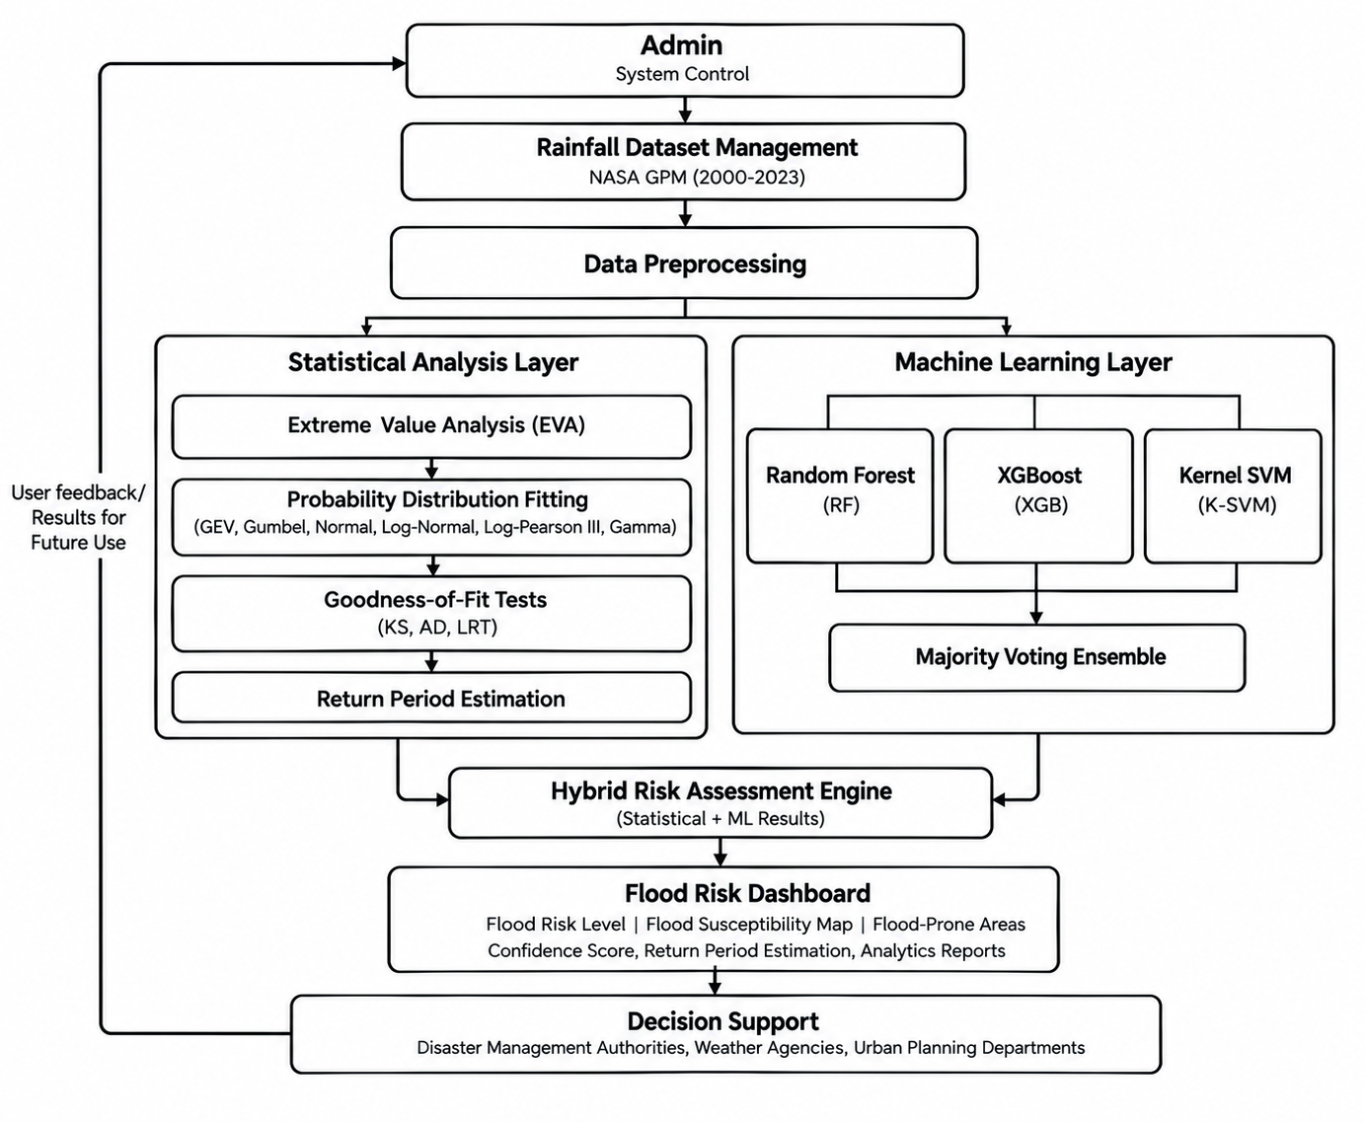
System Architecture
1. Data Management
Admin
NASA GPM Dataset
Rainfall Dataset Management
2. Data Processing
Data Preprocessing
Data Cleaning & Preparation
3. Statistical Analysis
Extreme Value Analysis (EVA)
Probability Distribution Fitting
Goodness-of-Fit Tests
Return Period Estimation
4. Machine Learning
Random Forest
XGBoost
Kernel SVM
Majority Voting Ensemble
5. Risk Assessment
Hybrid Risk Assessment Engine
Flood Risk Classification
Confidence Score
6. Decision Support
Flood Susceptibility Map
Flood-Prone Areas
Return Period & Analytics Reports

Slide 13
Proposed Outcomes
The system is expected to identify the probability distribution that best represents extreme rainfall behaviour.
Flood-prone and non-flood-prone regions are expected to be identified using the combined machine learning predictions.
Flood return periods and confidence scores are expected to be generated for regional flood-risk assessment.
Flood susceptibility maps are expected to provide a clear visual representation of high-risk regions.
An interactive dashboard is expected to provide a consolidated view of flood risk, analytics, and model performance for disaster-management decision making.

Slide 14
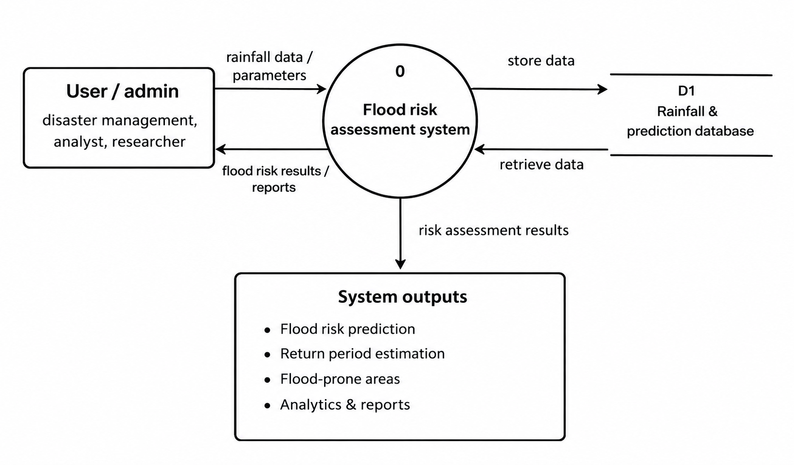
DFD Diagram: Level 0

Slide 15
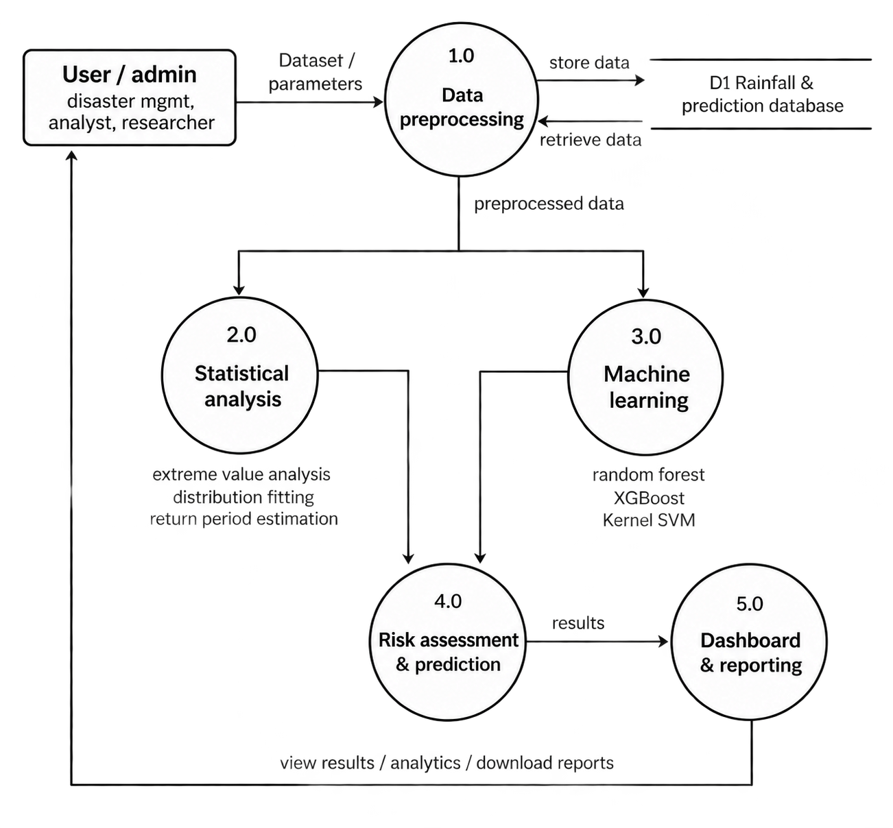
DFD Diagram: Level 1

Slide 16
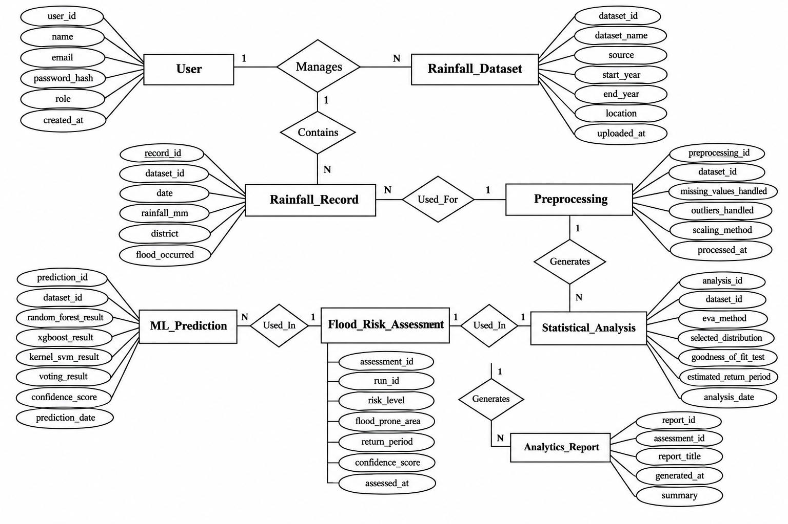
ER Diagram

Slide 17
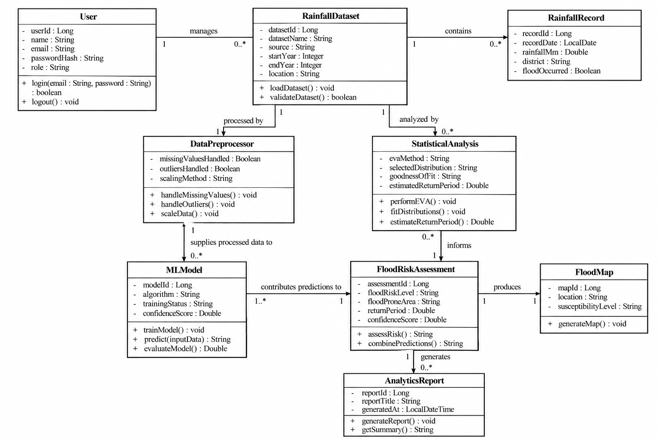
Class Diagram

Slide 18
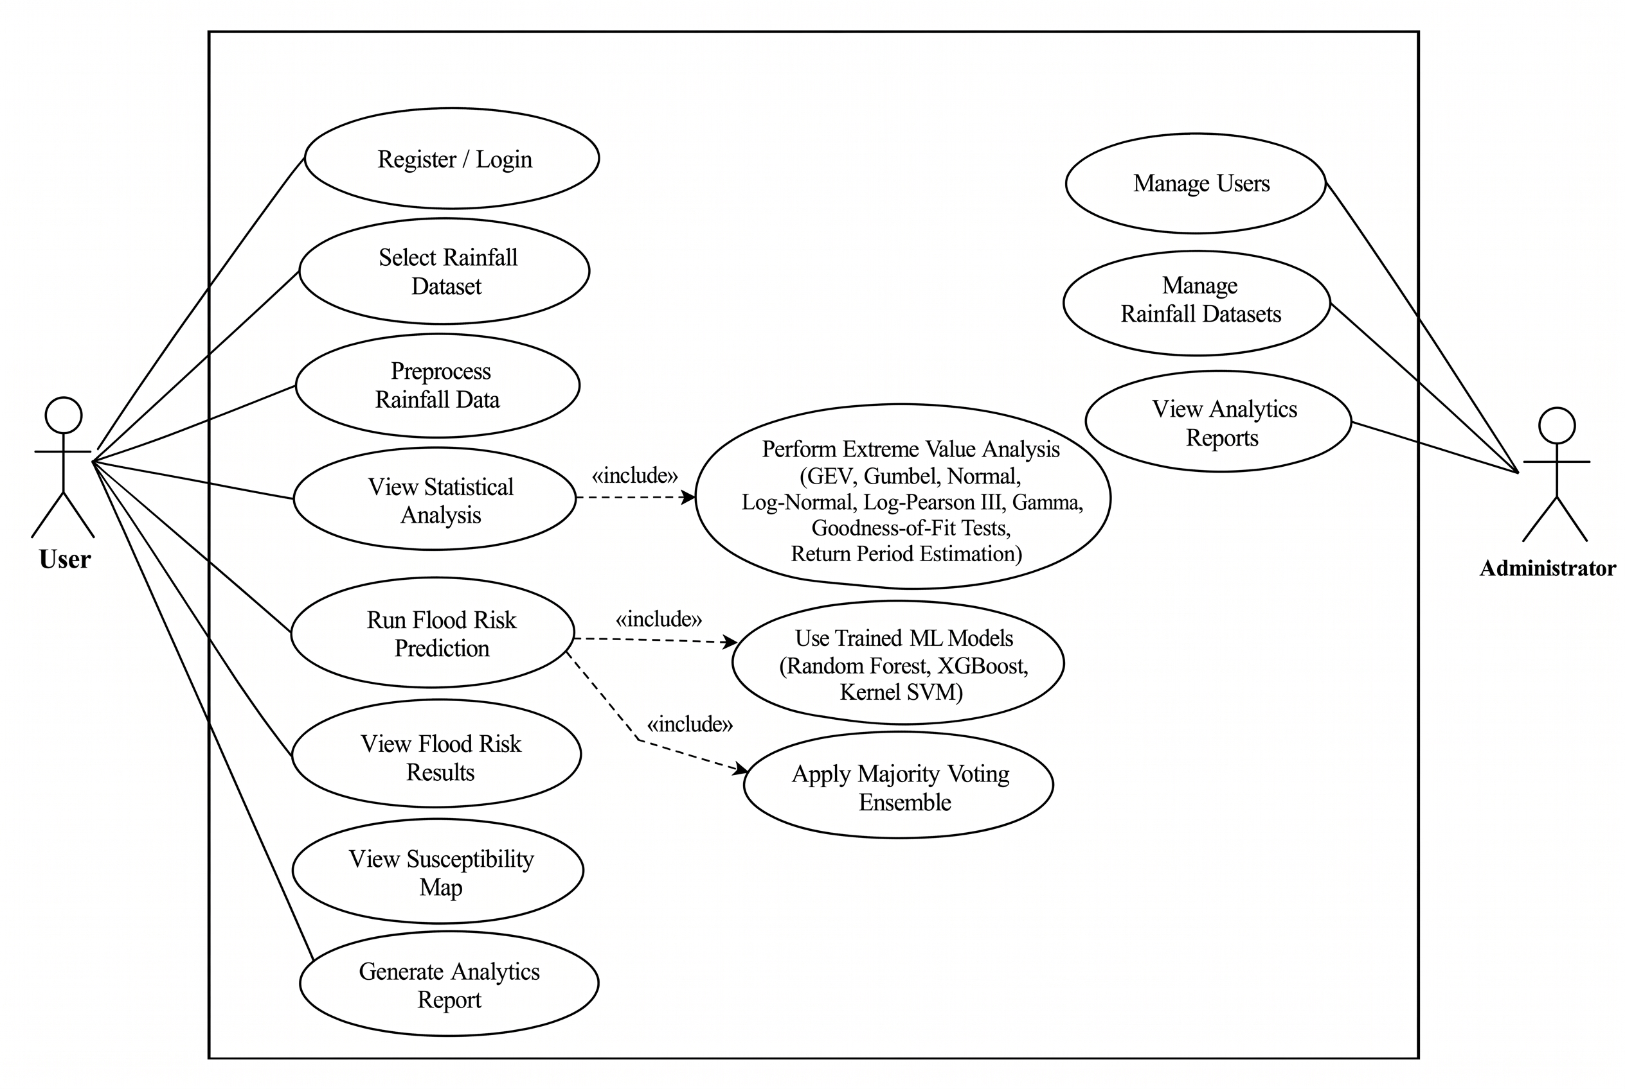
Use Case Diagram

Slide 19
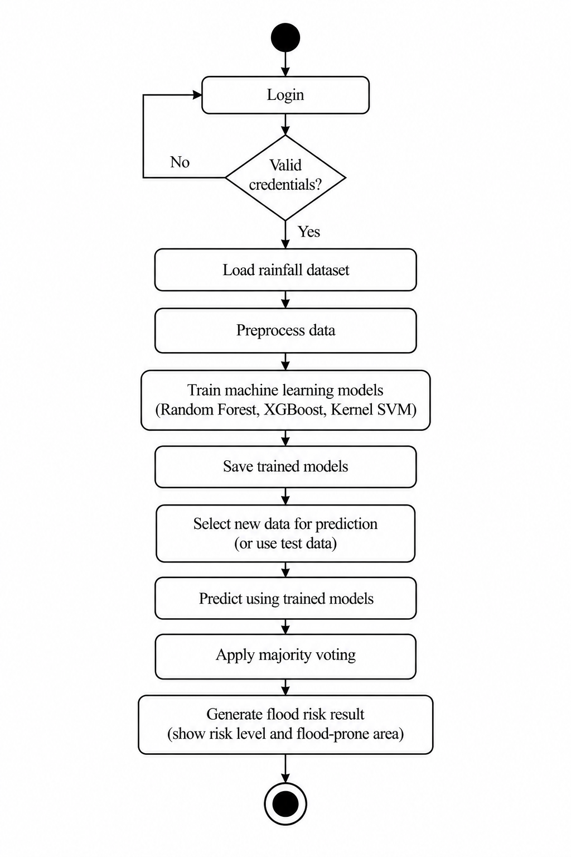
Activity Diagram

Slide 20
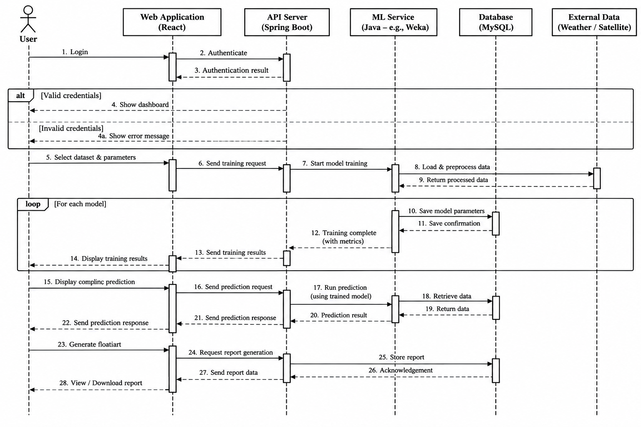
Sequence Diagram

Slide 21
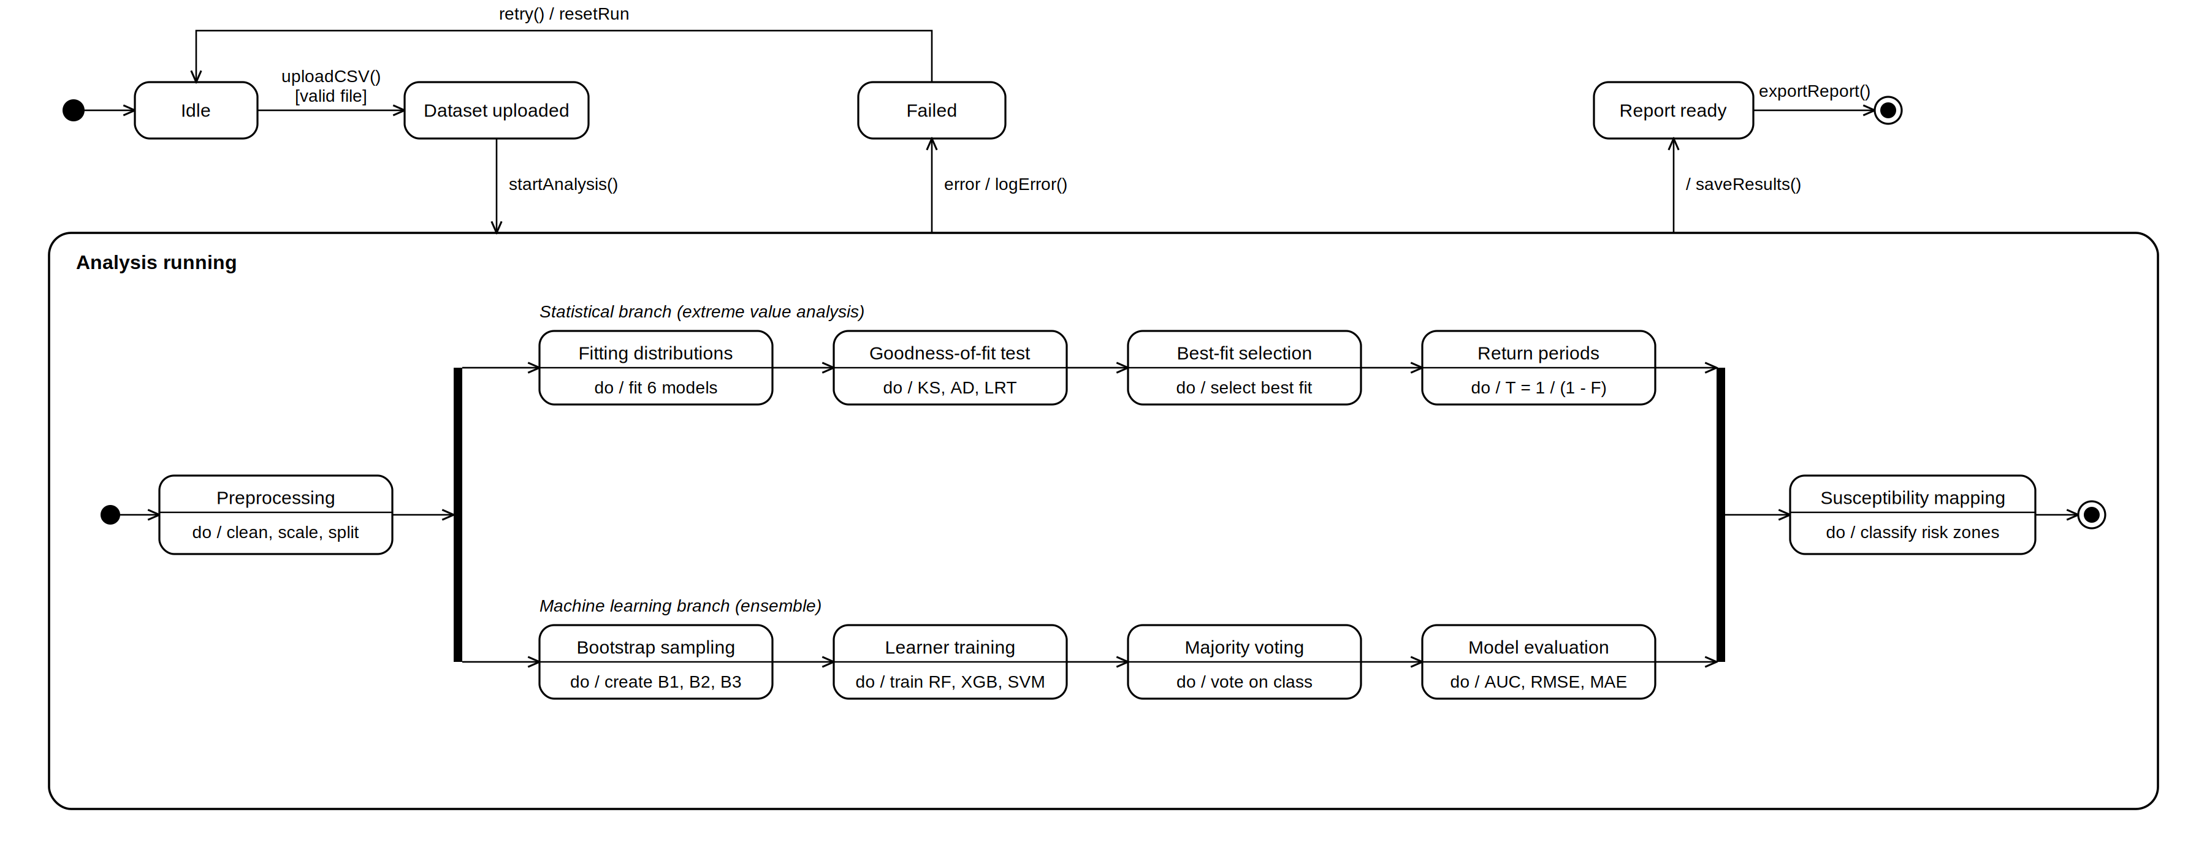
State Diagram

Slide 22
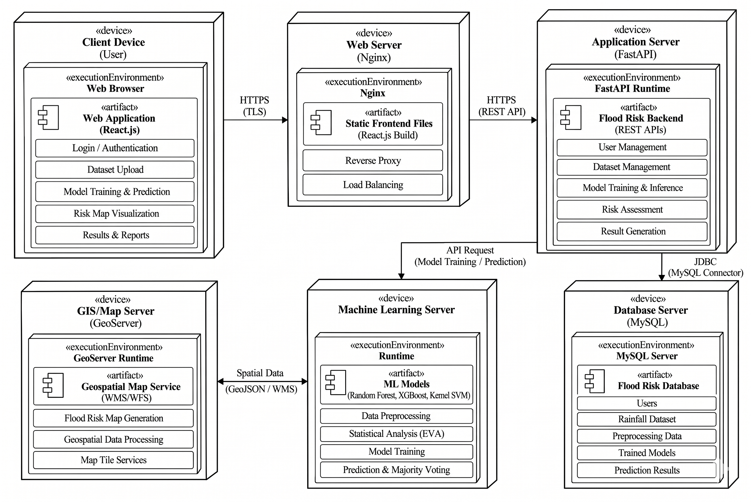
Deployment Diagram

Slide 23
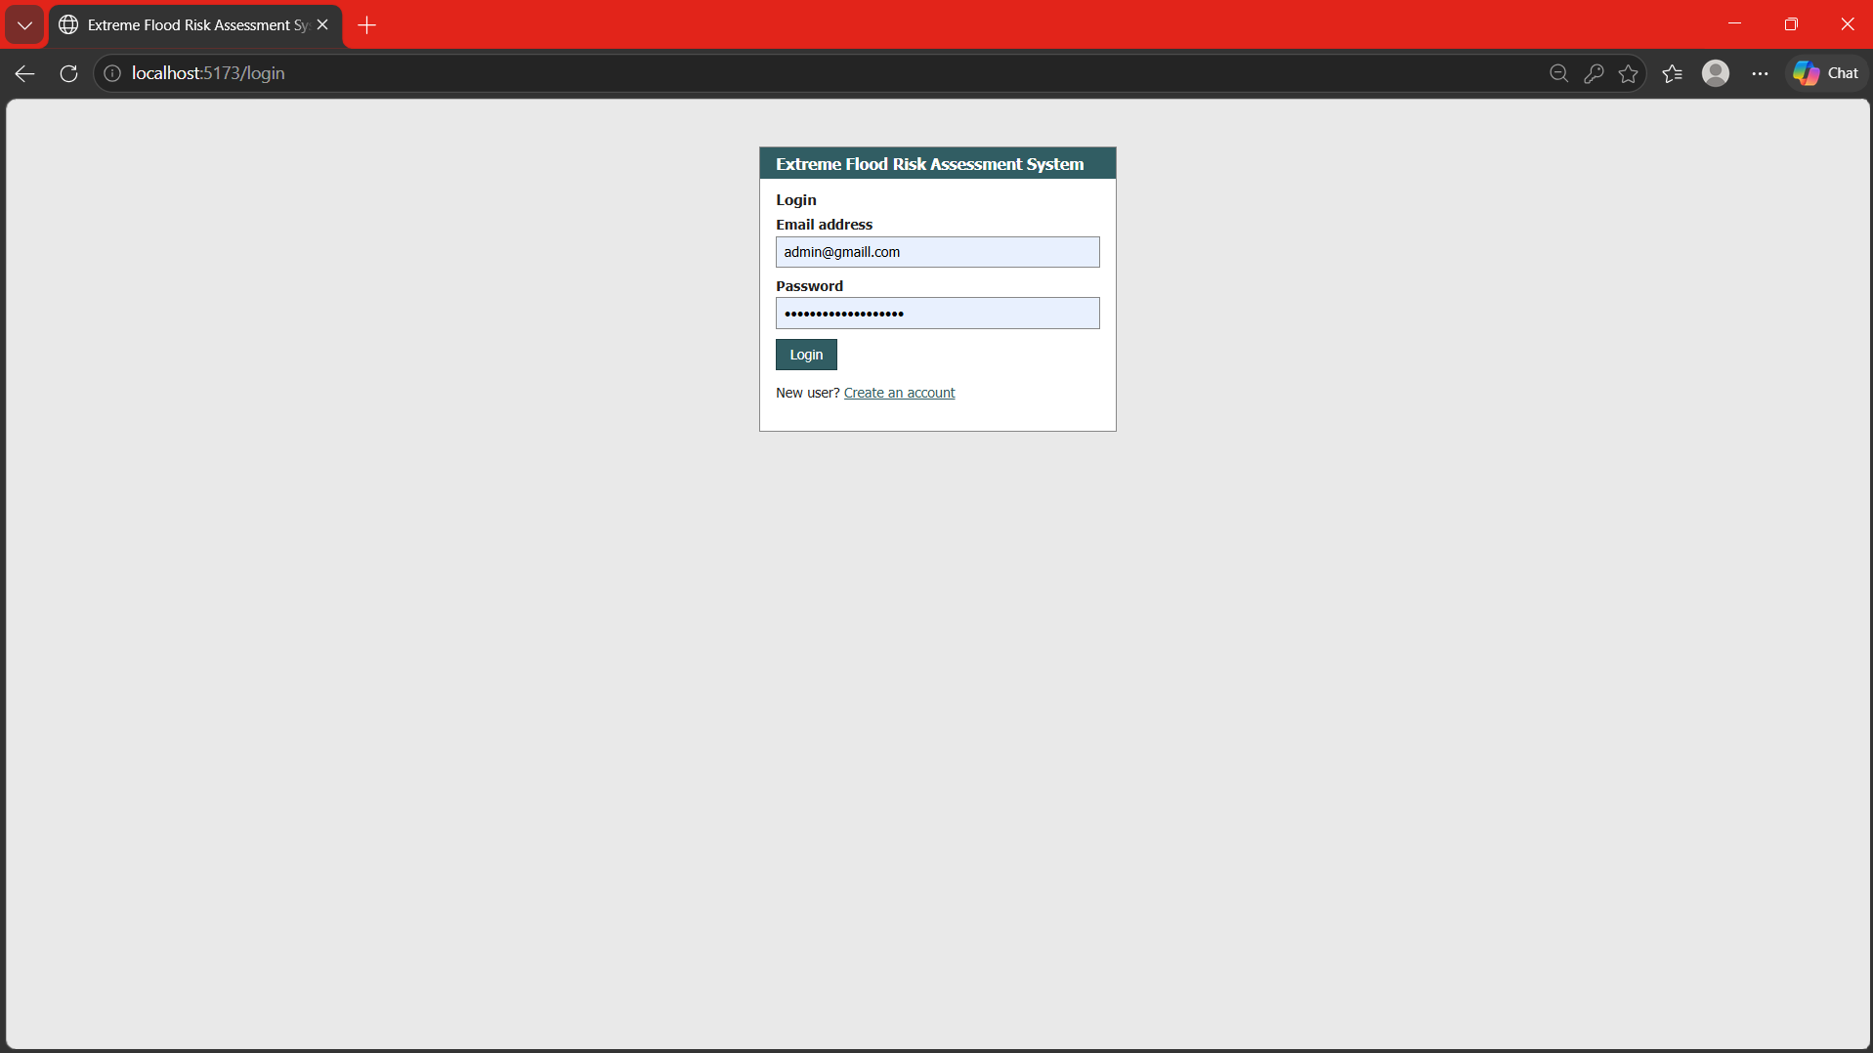
Results

Slide 24
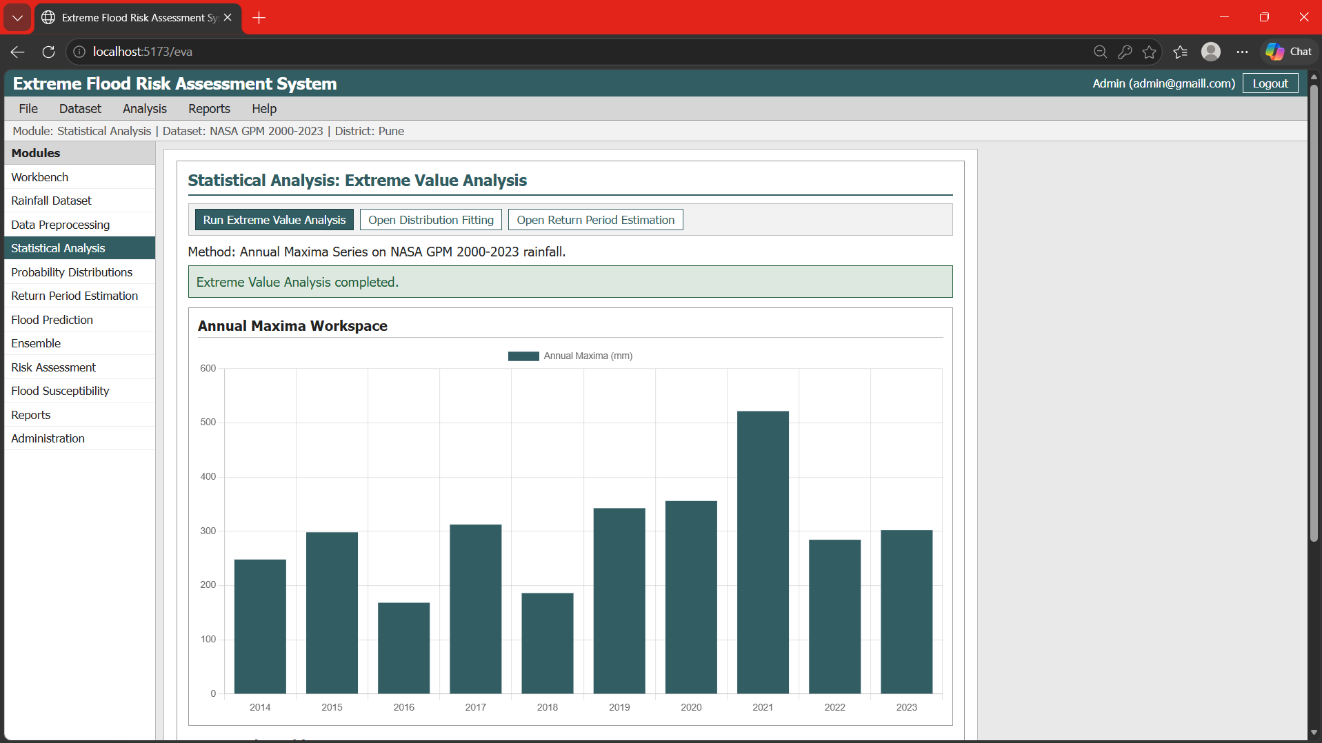
Results

Slide 25
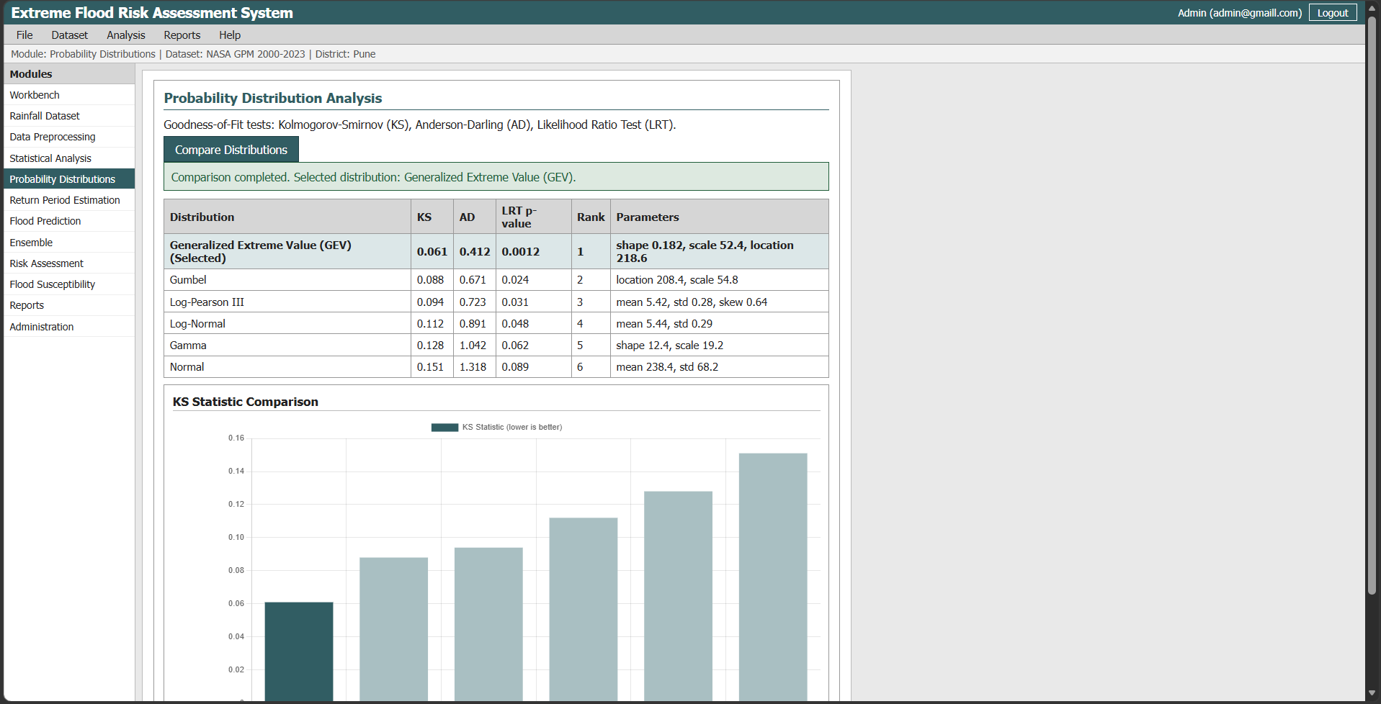
Results

Slide 26
System Requirements
Hardware Requirements:
Processor: Intel i5 or Higher
RAM: Minimum 8 GB
Storage: Minimum 256 GB
Windows/Linux Compatible System
Software Requirements:
Operating System: Windows or Linux
Frontend: React, Chart.js
Backend: Java 21, Spring Boot
Database: MySQL / PostgreSQL
Machine Learning Tools: Smile ML, XGBoost4J
Dataset: NASA GPM (Global Precipitation Measurement)

Slide 27
Conclusion
The proposed Probabilistic-ML Framework for Extreme Flood Prediction combines Extreme Value Analysis, probability distribution methods, and machine learning to reliably assess extreme flood risk using historical rainfall and hydro-meteorological data. It estimates extreme rainfall return periods and uses Random Forest, XGBoost, and Kernel SVM with Majority Voting to predict flood risk.
The results are presented through an interactive dashboard and susceptibility maps to identify flood-prone regions and support disaster management and planning. The proposed Java-based system provides a structured framework combining statistical and machine learning approaches for effective extreme flood risk assessment.

Slide 28
References
N. Fatima, H. M. Alshahrani, H. Dafaalla, R. Allafi, C. Kim, M. Syafrudin and N. L. Fitriyani, "Integrating Machine Learning Models With Probability Distribution Methods for Extreme Flood Risk Assessment," IEEE Access, vol. 13, pp. 160922–160938, 2025.
H. Hamidifar and M. Nones, "Spatiotemporal variations of riverine flood fatalities: 70 years global to regional perspective," River, vol. 2, no. 2, pp. 222–238, May 2023.
M. A. U. R. Tariq, R. Farooq and N. van de Giesen, "A critical review of flood risk management and the selection of suitable measures," Appl. Sci., vol. 10, no. 23, p. 8752, Dec. 2020.
D. Murtaza, T. Roshni and D. Himayoun, "The investigation of runoff variations and the flood frequency estimates of the Jhelum River, India," Sustain. Water Resour. Manage., vol. 8, no. 3, p. 60, Jun. 2022.
A. R. Al-Aizari, H. Alzahrani, O. F. AlThuwaynee, Y. A. Al-Masnay, K. Ullah, H.-J. Park, N. M. Al-Areeq, M. Rahman, B. Y. Hazaea and X. Liu, "Uncertainty reduction in flood susceptibility mapping using random forest and eXtreme gradient boosting algorithms in two tropical desert cities, Shibam and Marib, Yemen," Remote Sens., vol. 16, no. 2, p. 336, Jan. 2024

